Slide 1
Voice of Customers
: Mining Online Customer Reviews
for Product Feature-based Ranking
KYC w/ IDLE
목차
CONTENTS 1 Background & Purpose
CONTENTS 2 Abstract
CONTENTS 3 Workflow
CONTENTS 4 Result & outputs
CONTENTS 5 Evaluation
팀장
고원희
팀원
심재용
팀원
유영창
팀원
임진하
Voice of Customers: Mining Online Customer Reviews for Product Feature-based Ranking

Slide 2

X
○
Main Idea & Purpose
Ⅰ. Data Scraping
Ⅱ. Opinion Mining
Ⅲ. Identifying Comparative sentences
Ⅳ. PaperRank Algorithm
Voice of Customers: Mining Online Customer Reviews for Product Feature-based Ranking

Slide 3
X
○
Abstract
Online Data
Crawling
Comparative
Sentence
Identification
Graph
Construction
Information
Extraction
Subjective
Sentence
Identification
Sentence
Splitter
Product
Ranking
Sentiment
Analysis
POS Tagging
Voice of Customers: Mining Online Customer Reviews for Product Feature-based Ranking

Slide 4
X
○
Workflow
Feature Labeling
Sentiment Labeling
pRank Algorithm
02
04
06
01
03
05
Review Scraping
CS / SS Labeling
Product Dictionary
Voice of Customers: Mining Online Customer Reviews for Product Feature-based Ranking

Slide 5
X
○
Amazon Review
01
Amazon Digital Camera Section에 있는 리뷰를 Scrapy를 활용, 39603 개의 리뷰를 크롤링
Product Asin
02
같은 방식을 활용하여 상품들의 ASIN 코드들을 가져와 사전을 구축
Julian McAuley Data
03
이전 Julian McAuley의 Dataset에서 카메라에 관한 리뷰만을 필터링하여 58281개의 리뷰를 추출
Data Merging
04
두 데이터를 병합하여 중복 제거 →
92600개의 리뷰를 기반
Sentence Tokenizing
05
NLTK를 활용하여 리뷰들의 문장들을 분리 → 56281개의 문장으로 분리
Voice of Customers: Mining Online Customer Reviews for Product Feature-based Ranking

Slide 6
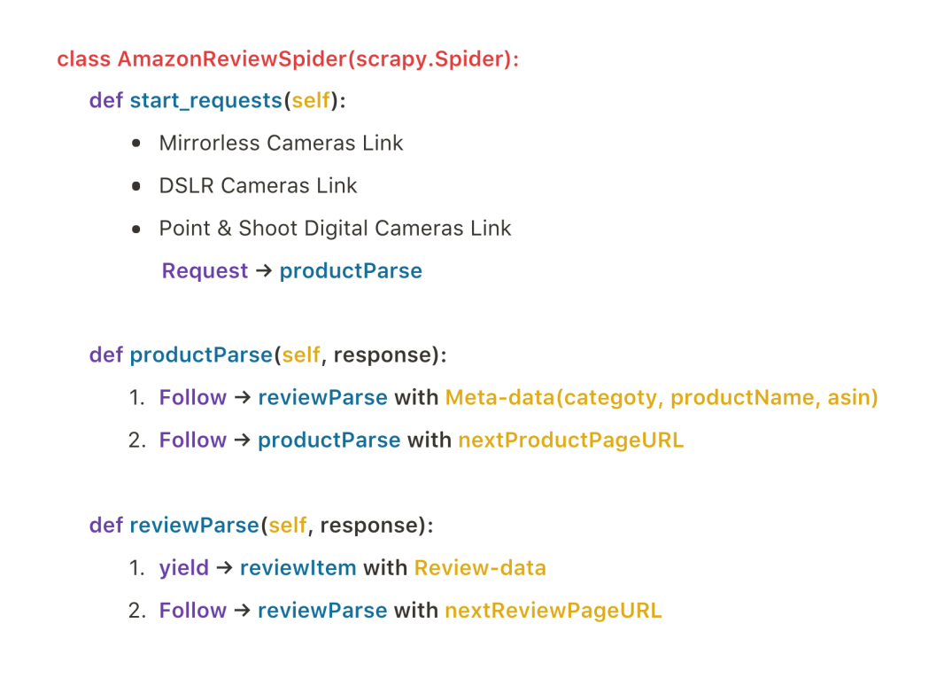
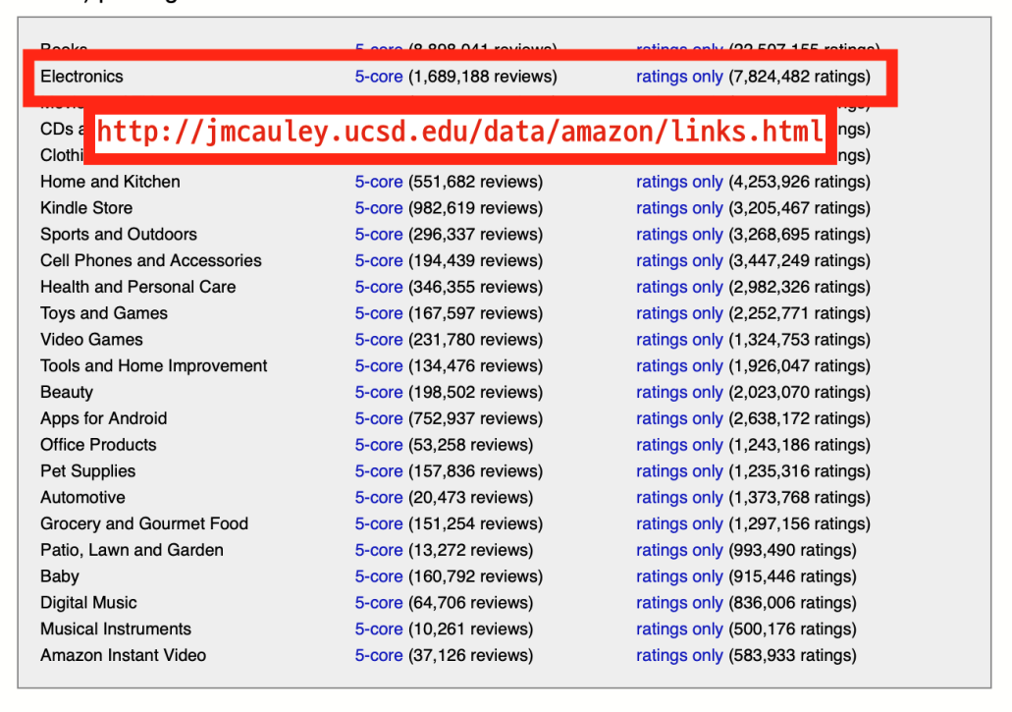
X
○
Data Resources
Category
Point & Shoot Digital Camera
DSLR Cameras
Mirror-less Camera
Date Range
1999-07-13 ~ 2019-08-11
III. Data Amount
- 92600 reviews
- 562816 sentences
Voice of Customers: Mining Online Customer Reviews for Product Feature-based Ranking

Slide 7
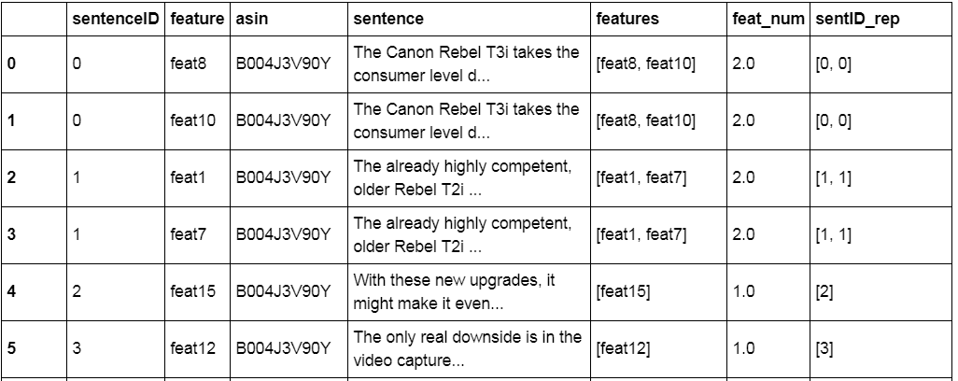
X
○
Feature Labeling
Resolution / Pixel / Megapixel
Lens / Angle
Zoom / Optical
Memory / Megabytes
Motion / Stability
Battery / Power
Focus / Exposure
LCD / Screen / Touch
Compression / Compress
Flash / Light / Shoe
Durability / Sealing
Video / Film / MIC
Mode / Program / Automatic
Weight / Voluminous
Feature Labeled
Sentence duplicated if multiple features
415646 Sentences
Original 10 Features
- 논문에서 가져옴
5 Extra Features
Voice of Customers: Mining Online Customer Reviews for Product Feature-based Ranking

Slide 8
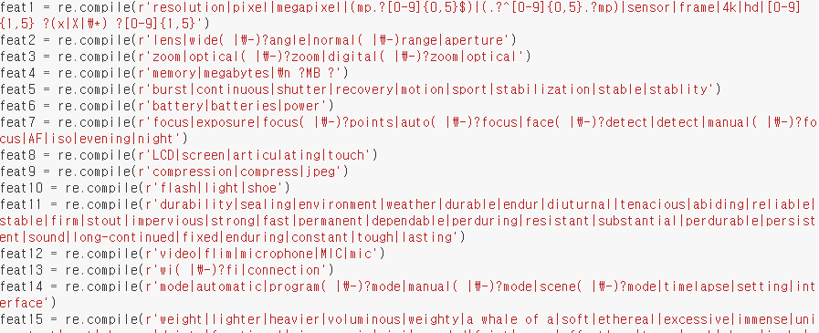
Voice of Customers: Mining Online Customer Reviews for Product Feature-based Ranking

Slide 9
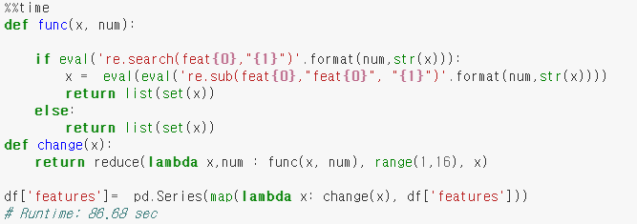
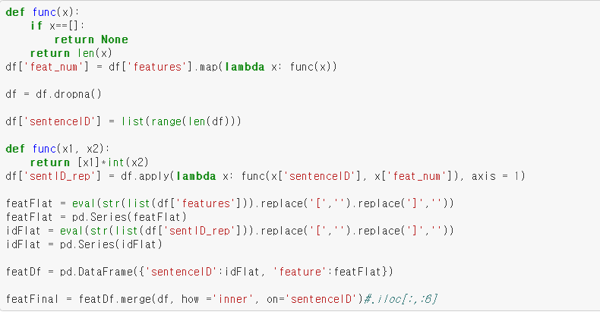
Voice of Customers: Mining Online Customer Reviews for Product Feature-based Ranking

Slide 10
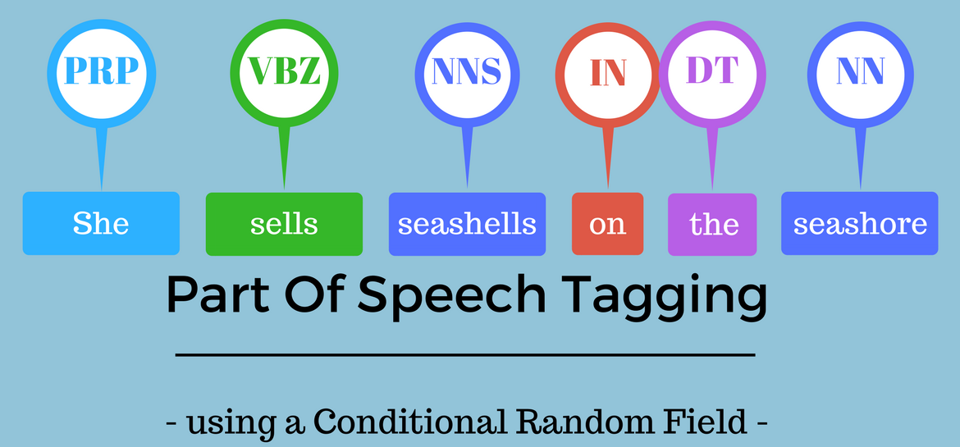
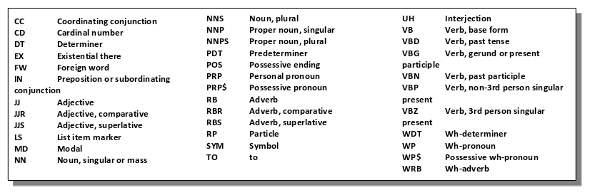
X
○
POS Tagging
NLTK POS Tagging
Filtering sentences with JJR, JJS, RBR, RBS
KW (54 words)
63 Comparative sentence keywords by Bing Liu
Eliminated too generic words
→ Approximately 150 K comparative sentences
Voice of Customers: Mining Online Customer Reviews for Product Feature-based Ranking

Slide 11
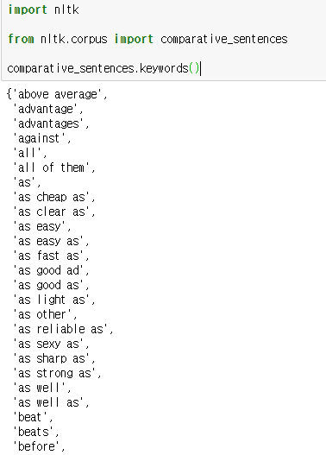
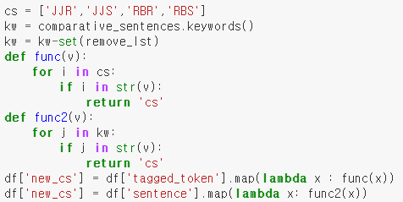
X
○
CS Labeling
Examples:
JJ: The dog is black / The milk smells rotten
RB: She sang beautifully / The cellist played carelessly
JJR: This is a faster car than the previous one.
JJS: This is the fastest car here.
RBR: Can you speak faster?
RBS: He drove the worst possible.
Voice of Customers: Mining Online Customer Reviews for Product Feature-based Ranking

Slide 12
X
○
Sentiment Labeling
MPQA
Approx 59000 ‘neg’
78% accuracy
Opinion Lexical
NLTK sentiment analyzer
Approx 56000 ‘neg’
66% accuracy
Test version
VADER sentiment analyzer
Approx 75000 ‘neg’
87% accuracy
Twitter based analyzer
* Randomly sampled 100 sentences to analyze accuracy
Voice of Customers: Mining Online Customer Reviews for Product Feature-based Ranking

Slide 13
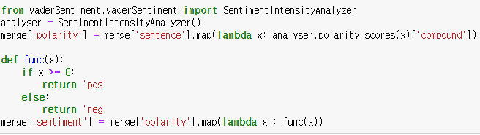
Voice of Customers: Mining Online Customer Reviews for Product Feature-based Ranking

Slide 14
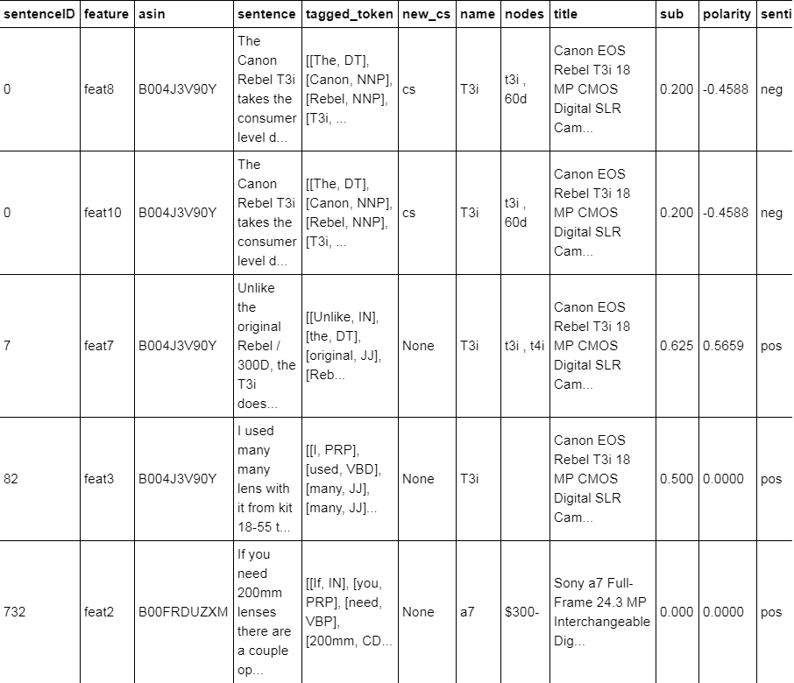
Voice of Customers: Mining Online Customer Reviews for Product Feature-based Ranking

Slide 15
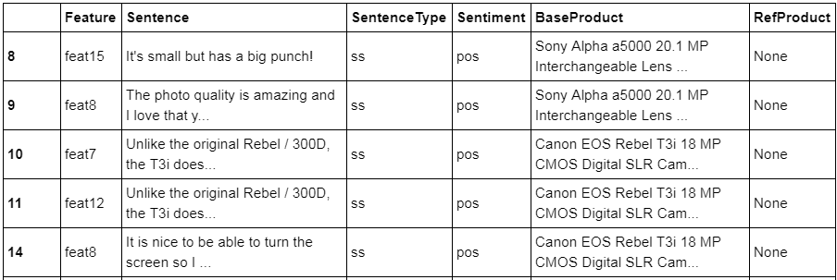
X
○
Product Recognition
& Graph Construction
SS condition:
new_cs != ‘cs’ & sub != 0
비교문장이 아니면서
주관성이 0 인 문장을 제외
Excepting
CS Labeled Sentence
Excepting
Subjectivity
= 0
Extracting
SS
Sentences
Extracting
Base
Products
Voice of Customers: Mining Online Customer Reviews for Product Feature-based Ranking

Slide 16
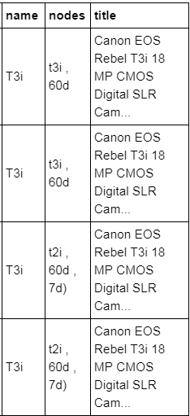
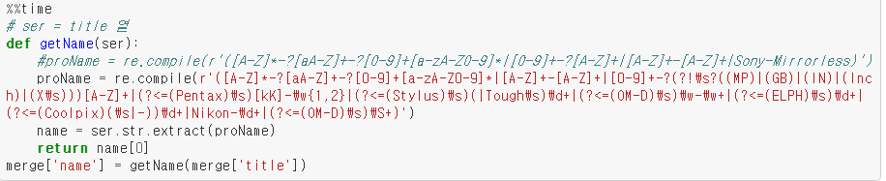
X
○
Product Recognition
& Graph Construction
리뷰에서 특정 제품을 언급하기 위해
꼭 말해야 하는 모델명을 제품명에서 추출하기
Ex. 'DMC-GH3K', DMC-FZ150K', 'F300EXR', 'DMC-FZ8K', 'H200', 'T6', 'DSC-H55'
Voice of Customers: Mining Online Customer Reviews for Product Feature-based Ranking

Slide 17
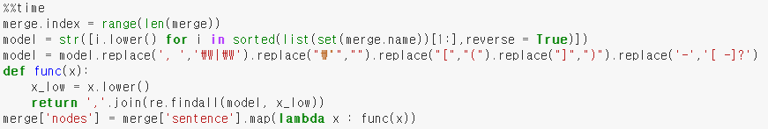
X
○
Product Recognition
& Graph Construction
모델명 이름을 나타내는 열을 모두 합해서 정규표현식으로 표현,
그 정규표현식을 모든 문장에 대해서 re.findall을 실행
Voice of Customers: Mining Online Customer Reviews for Product Feature-based Ranking

Slide 18
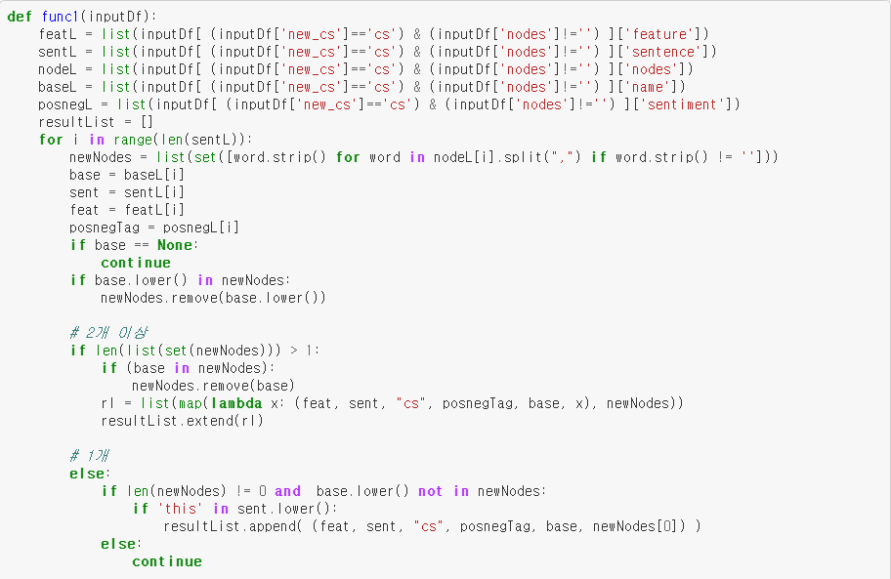

Slide 19
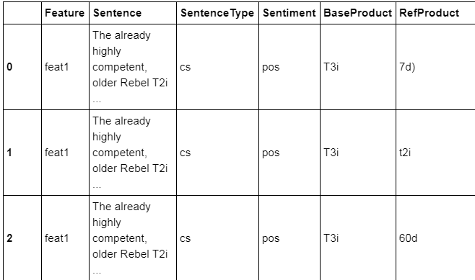
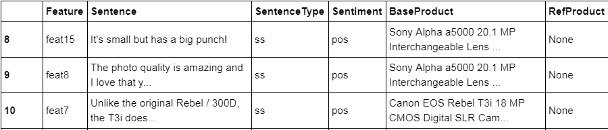
X
○
CS Labeled sentences / SS Labeled sentences
→ Merge to Final DataFrame
Voice of Customers: Mining Online Customer Reviews for Product Feature-based Ranking

Slide 20
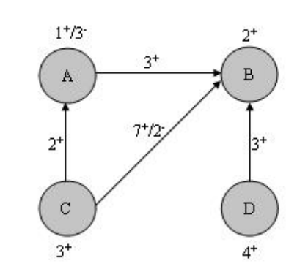
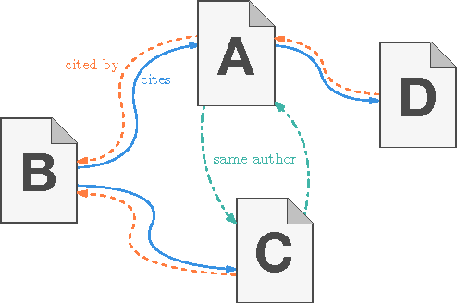
X
○
pRank Algorithm
paperRank Algorithm
- Method by Larry Page firstly developed in 1999
pRank Algorithm
Modified by Kunpen Zhang
Self-node added
Voice of Customers: Mining Online Customer Reviews for Product Feature-based Ranking

Slide 21
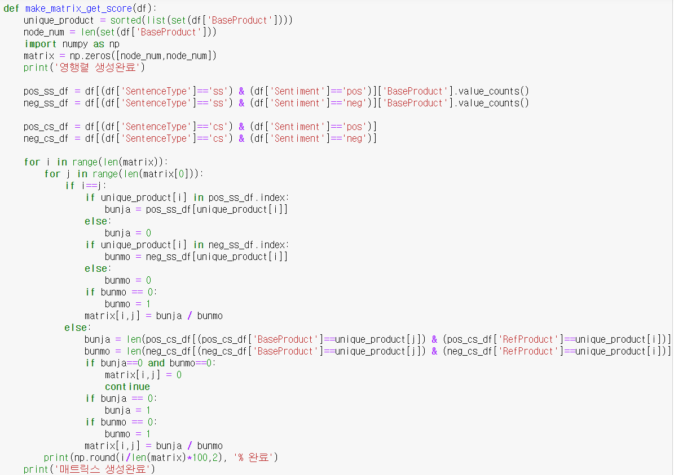

Slide 22
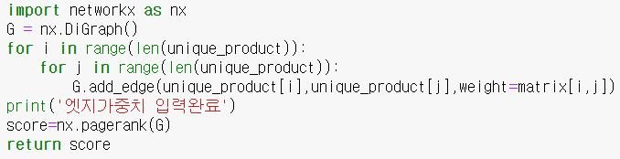
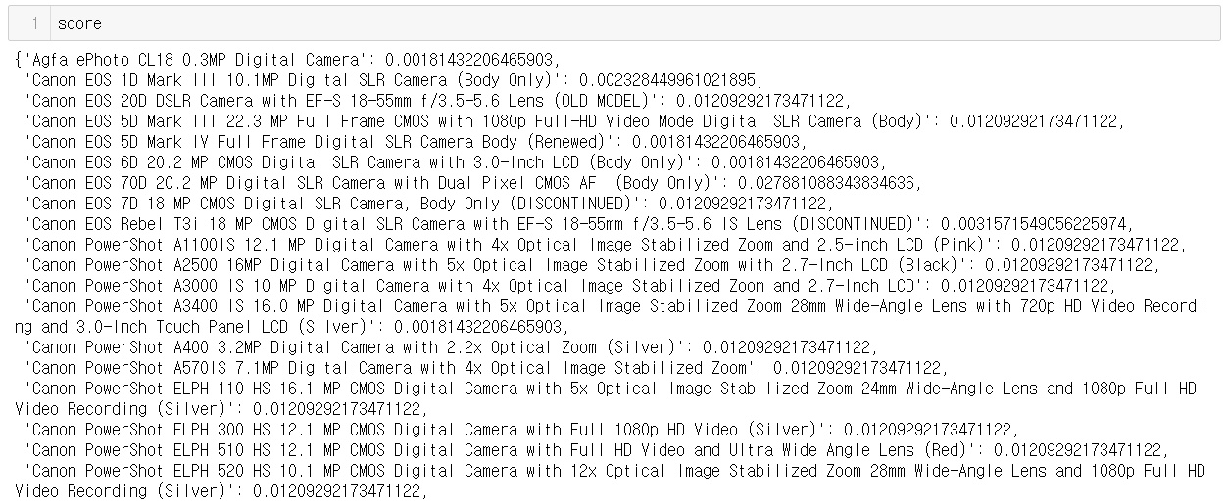
X
○
pRank Algorithm
Voice of Customers: Mining Online Customer Reviews for Product Feature-based Ranking

Slide 23
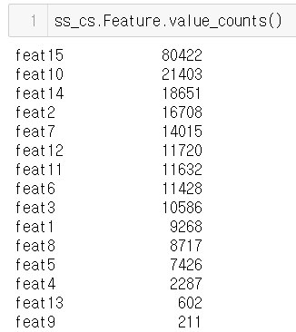
X
○
Result
특정 피쳐에 해당하는 문장 수가 많을 수록 언급되는 제품이름이 많아짐. 제품 수가 많을수록 매트릭스의 크기가 커지므로 연산 시간이 길어짐.
Feat9의 경우 211개의 문장에서 119개의 제품이 언급되었고, 119*119 매트릭스를 이중 for문을 이용해 생성하는데 너무 많은 시간이 걸렸음.
Voice of Customers: Mining Online Customer Reviews for Product Feature-based Ranking

Slide 24
X
○
고원희
Feature Labeling
Extracting Product names
새로운 팀장
VOC
project
심재용
Data Scraping
Reference Product Labeling
서류전형 X
PPT 능력 X
유영창
pRank Algorithm
King
임진하
Identifying Comparative sentences
Sentiment analyze

Slide 25
Thank you

